Slide 1
PRESENTATION
By Team DataVerse
Techcrush Capstone Project

Slide 2
Predictive Modeling for Early Diabetes Detection
A Data-Driven Approach to Proactive Healthcare
Techcrush Capstone Project

Slide 3
The Problem Statement:
The Challenge: Reducing Crowding In Hospital & Early Detection Of Diabetes In a Patient.
Our goal is to create a tool for a mobile clinic to efficiently pre-screen for diabetes.
  The Problem: Mobile clinics need a low-cost, effective way to identify patients at high risk of diabetes.
  The Goal: Prioritize resources and focus medical attention on those who need it most.
  The Impact: Improve patient outcomes through early intervention and reduce strain on larger hospitals.

Slide 4
Our Project Objectives:
From Data to Diagnosis
A two-step approach to building a reliable predictive model.
  Explore the Data (EDA) Uncover the factors that most significantly influence diabetes risk.
2. Build a Predictive Model Develop a robust classification model to predict a patient's diabetes status using key health indicators.
Raw Data -> Analysis -> Predictive Model.

Slide 5
The Dataset: Pima Indians Diabetes
The Data We Worked With
We used a well-known, standard dataset for this classification problem.
  Dataset: Pima Indians Diabetes Dataset
  Records: 768 anonymized patient records
  Features: 8 key health indicators, including: Glucose BMI Age Pregnancies
  Target: The Outcome column (0 = Non-Diabetic, 1 = Diabetic)

Slide 6
Initial Finding: The Hidden Data Problem
The Data Wasn't as Clean as It Seemed
A critical discovery: '0' values in key features were actually missing data.
  We found physiologically impossible 0 values in:
  Glucose: 5 instances
  Blood Pressure: 35 instances
  BMI: 11 instances
  Insulin: 374 instances
  Our Solution: We treated these as missing data and imputed them with the median value of each column, a method robust to outliers.

Slide 7
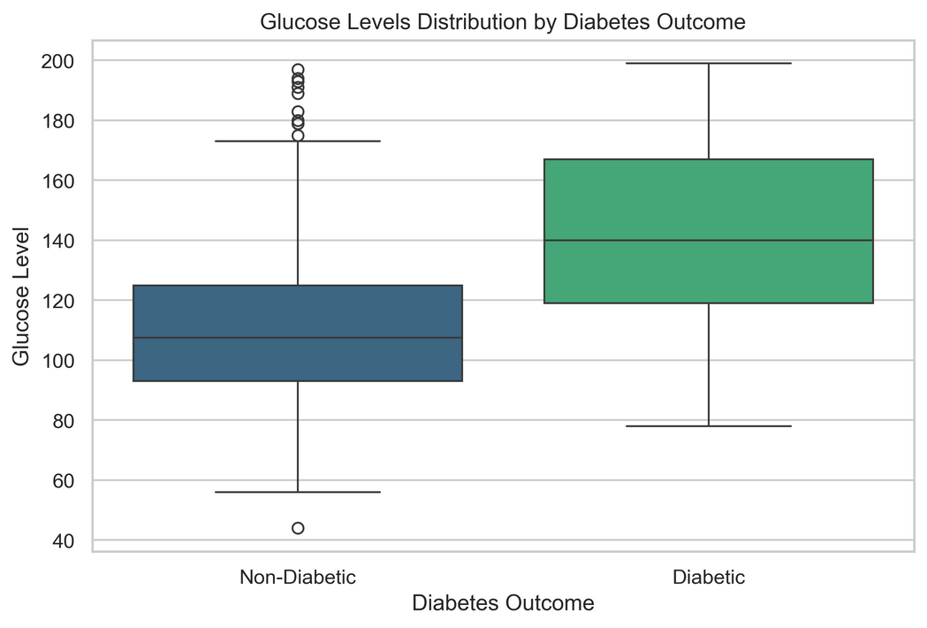
Key Insight #1: Glucose is the Strongest Predictor
EDA: Glucose Levels Clearly Separate the Outcomes
The data showed a significant difference in glucose levels between the two groups.
  Median Glucose (Diabetic): 140
  Median Glucose (Non-Diabetic): 107.5
This confirmed that Glucose is the most powerful feature for predicting diabetes.

Slide 8
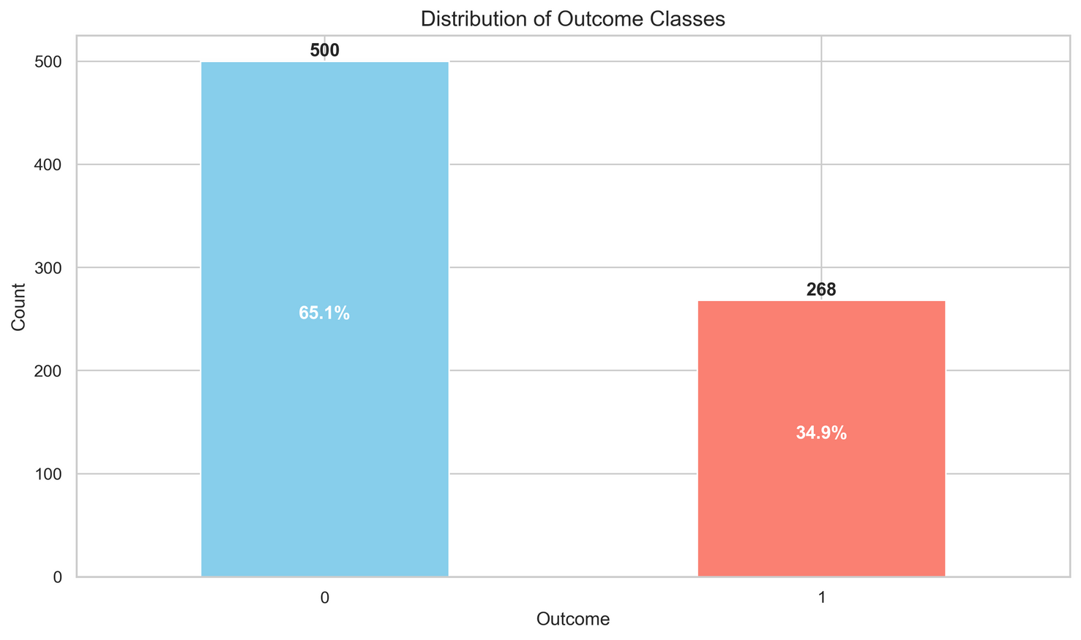
Key Insight #2: The Imbalance Problem
EDA: An Imbalanced Dataset
Our dataset had nearly twice as many non-diabetic records as diabetic ones.
  Non-Diabetic (Class 0): 500 patients (65.1%)
  Diabetic (Class 1): 268 patients (34.9%)
The Risk: Without careful handling, a model could become very good at just predicting "non-diabetic" while failing to identify the diabetic cases we need to catch.

Slide 9
Modeling: From Competition to Champion
Finding the Best Classifier
We tested multiple models and used advanced tuning to find the best performer.
  Models Tested: Logistic Regression, Random Forest, and SVM.
  Tuning: Used GridSearchCV to find the optimal parameters for the top models.
  Champion Model: Random Forest consistently showed the highest initial accuracy (78%).

Slide 10
The Critical Twist: Why Accuracy Isn't Enough
A False Negative is Not an Option
In healthcare, failing to identify a sick person is far more dangerous than a false alarm.
  Our Priority: Maximize Recall for the diabetic class (Class 1).
  What this means: We want our model to "catch" as many true diabetic cases as possible
  We deliberately shifted our focus from pure accuracy to maximizing this critical metric.

Slide 11
The Solution: A Refined & Balanced Model
Our Final Model: A Balanced Random Forest
We refined our best model to be more sensitive to the diabetic class.
  Final Model: Random Forest Classifier
  Technique #1: Class Weight Balancing
  We trained the model with class weight="balanced" to give more importance to the under-represented diabetic cases.
  Technique #2: Threshold Tuning
  We adjusted the decision boundary from 0.50 down to 0.45, making the model more likely to predict "diabetic" in borderline cases.

Slide 12
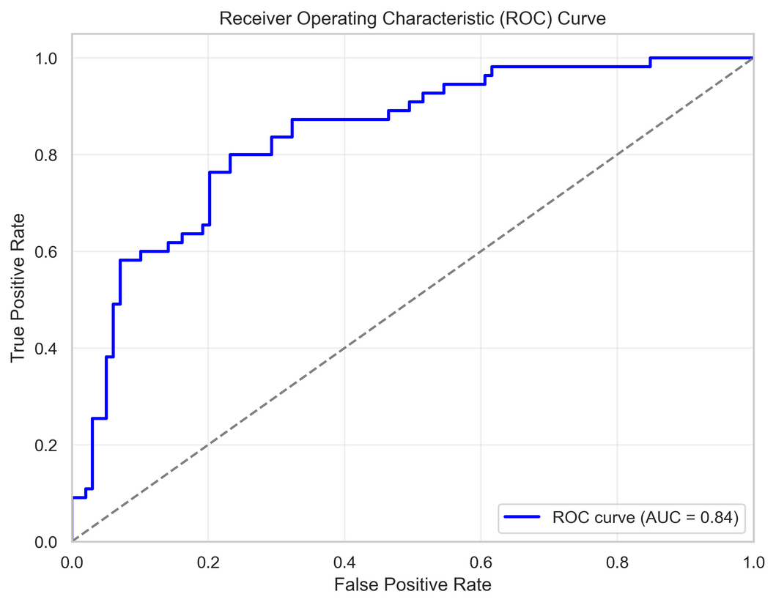
The Results: High Recall & High Confidence
Model Performance: Ready for Pre-Screening
Our final model successfully identifies 80% of diabetic patients with excellent overall performance.
  Recall (Diabetic): 80%
  Accuracy: 79% (from the balanced model)
  AUC Score: 0.84 (Excellent at distinguishing between classes)

Slide 13
Conclusion & Real-World Impact
From Data to Diagnosis: A Tool for Proactive Care
We successfully built a reliable model that can make healthcare more efficient and proactive.
  What We Delivered: A predictive model optimized for the early detection of diabetes.
How It Helps:
  Allows clinics to prioritize at-risk patients for follow-up tests.
  Reduces resource strain by focusing tests and staff time where it's needed most.
  Provides a crucial opportunity for early intervention, significantly improving patient outcomes.

Slide 14
Thank You

